Slide 1
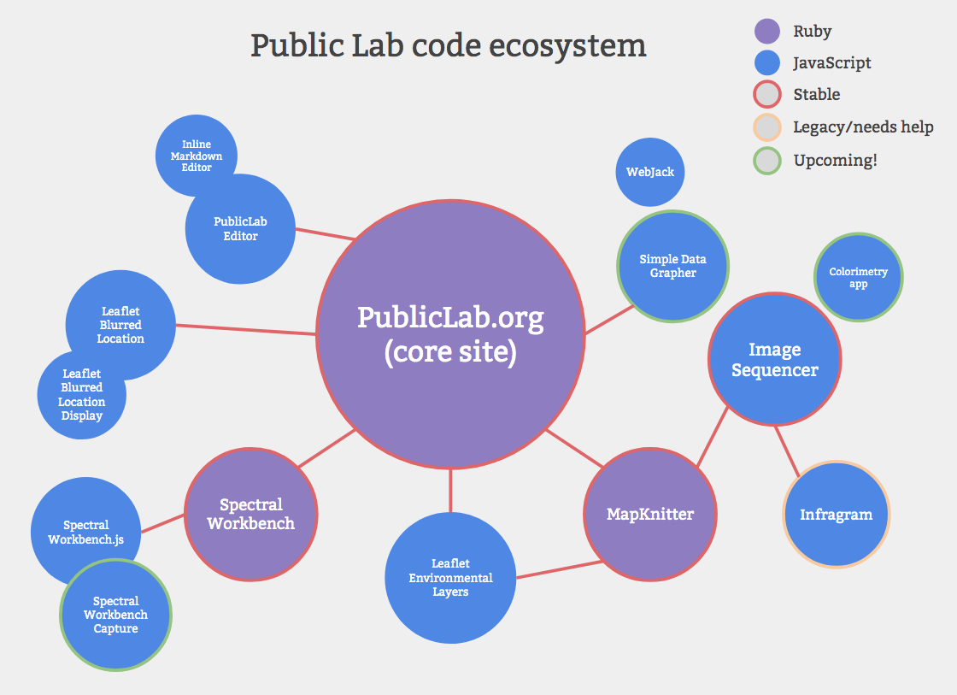
NDVI for cameras
with IR and red filters
Image processing
Grating Spectroscopy
Picture overlay on maps
NDVI for camera
w/red or blue filters
Overlay data on maps

